Slide 1
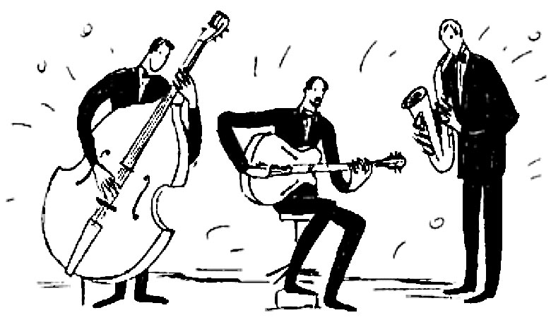
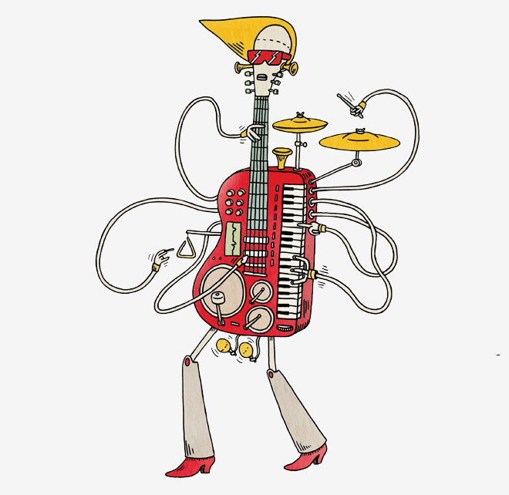
Question:
How can we build artificial performers that automatically improve their ability to sense, predict and respond to humans’ musical expression with limited rehearsal experience?
Answer: function approximation
We need another member
F ( )→
Demo: human solo with machine accompaniment
Danny Boy:
Rule-based Vs.
Spectral learning with just 4 rehearsals

